Slide 1

ADB Digital Utility Initiative
Kick-off Meeting - Digital roadmap for power sector utilities in Bhutan
Asian Development Bank
February 2025
Deloitte Touche Tohmatsu India LLP

Slide 2

COVERAGE
 | Project Context and Engagement Team Our understanding of the project and Project team
 | Scope of Work, Focus Areas and Work Plan Summary of the scope and key deliverables
 | Next Steps Way Forward
1
2
3

Slide 3

Project Context and Engagement Team

Slide 4



Project Context and Background …1/2
Bhutan’s power sector has experienced significant growth in recent years, driven by domestic hydropower generation and a strong focus on enhancing operational efficiency and digitalizing business processes within utilities.
IT-OT Assessment and Road Map for Power Utilities in Bhutan
Druk Green Power Corporation Limited (DGPC)
Bhutan Power System Operator (BPSO)
Bhutan Power Corporation Limited (BPC),
Key Metrics of Bhutan's Power Sector
*Source: Power Data Book, BPC
9%
19%
Steep demand growth in Peak Demand and Energy Sold between 2018 and 2023.
Energy Sales and Peak Demand are expected to grow further due to increase in domestic load.
Installed capacity target - 5 GW by 2030 and 15-20 GW by 2040
There’s substantial potential for system loss reduction through adoption of digital reforms.
Increased regional power market integration, improved customer services and capacity additions are key focus areas.
A digital roadmap is crucial to support the utility modernization initiatives and performance improvement.
20%
1%

Slide 5
Project Context and Background …2/2
Digitalization initiatives in utilities has been identified as a priority area by the SASEC Energy Working Group
Digitalization initiatives in utilities has been identified as a priority area by the SASEC Energy Working Group. in 2023 and 2024, member countries highlighted the need for support in making the regional utilities future-proof through comprehensive utility modernization efforts
Key Objectives of the Assignment
ACTIVITY 1
Assess current practices, digital maturity, and ongoing/planned initiatives
The strategic roadmap will outline a vision, mission, and implementation strategy for long-term digital transformation in the power sector.
ACTIVITY 2
Define short, medium, and long-term performance objectives
ACTIVITY 3
Develop a strategy with a time-bound digitalization and performance improvement roadmap
ACTIVITY 4
Prepare a detailed Cyber Security Capacity Building Plan
Increasing focus towards technological improvements and modernization of utilities
24x7 power supply, reliable grid
Digitalization of utilities
Network automation & upgradation
Rise of Value-Added Services
Structural Reforms
Supply of reliable and uninterrupted power to all
Smart Metering, Communicable Network Metering with AMI, Unified Billing Software, ERP, Load Forecasting etc.
Reduce losses, improve service quality through infra works, Feeder segregation, SCADA, DMS, OMS, etc.
Consumers are becoming aware and demanding service-based models
Re-engineering of business processes to make utilities more consumer centric

Slide 6

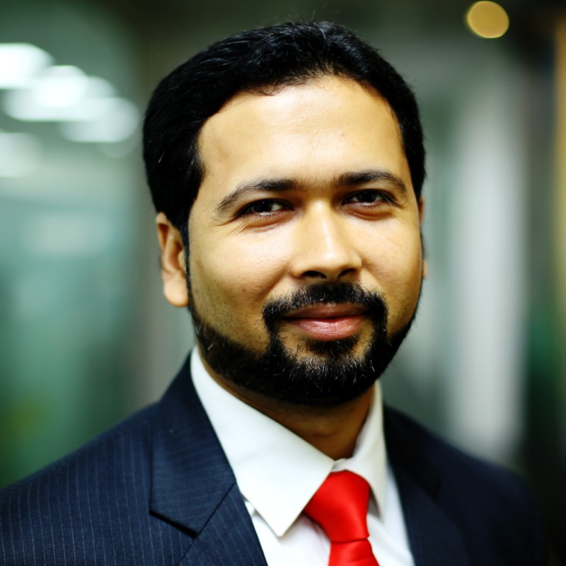

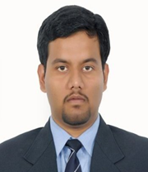

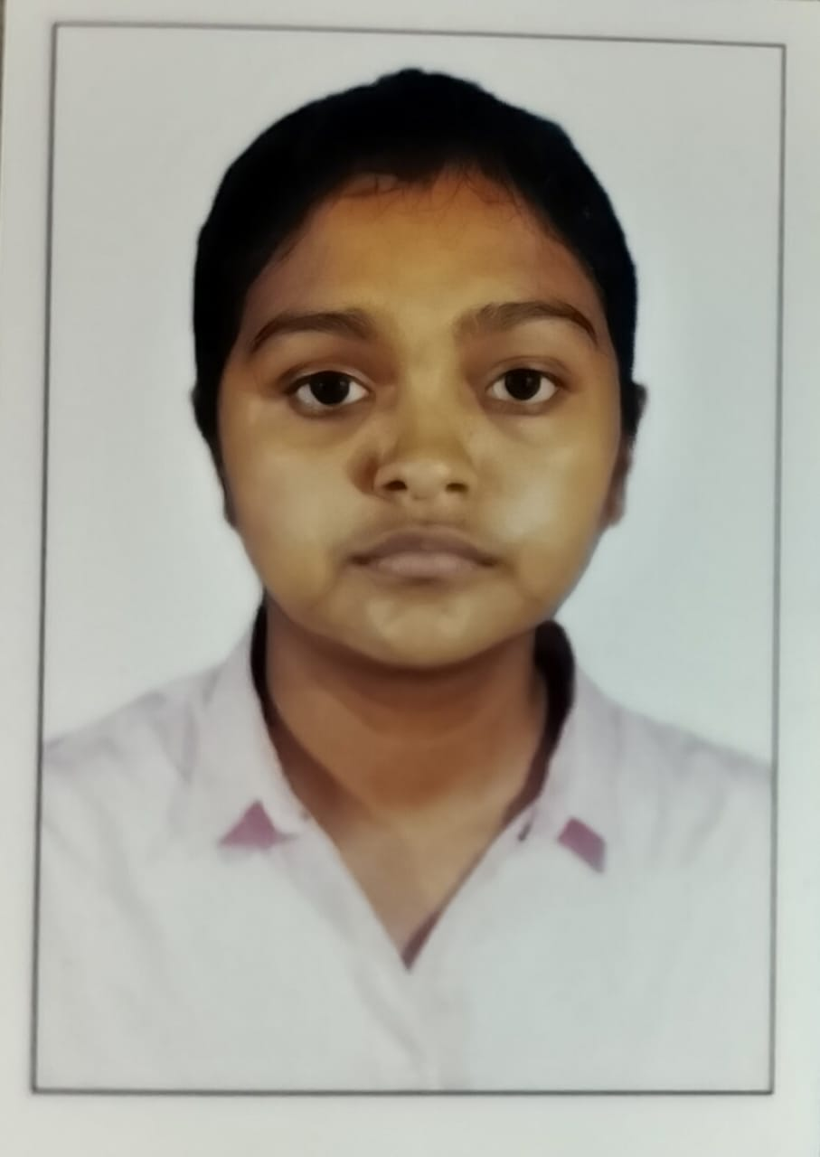
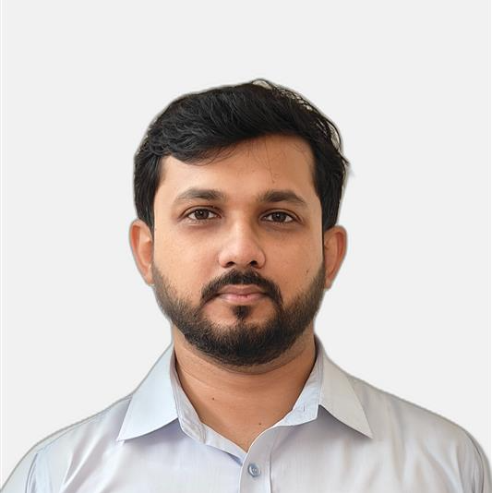
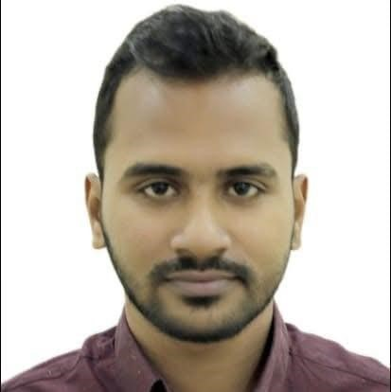
Here with you - Team
Our proposed team has deep expertise in digital transformation, business process re-engineering and cyber security among others
Key Experts
Review Mechanism
Subject Matter
Experts (SMEs)
Team Leader shall be the point of contact for all communications from BPC/BPSO/DGPC/Other Stakeholders
Sayan Mitra
(21+ Years experience)
Project Manager/Team Leader
Samrat Roy
(20+ Years experience)
Subject Matter Expert (SME)
Subject Matter Experts to review and provide feedback on various deliverables
Abhishek Bhargav
(16+ Years experience)
Cyber Security Expert
Aritra Roy
(10+ Years experience)
System Integration Expert
Siddharth Mani
(11+ Years experience)
Subject Matter Expert (SME)
Liaison and coordination through Senior Advisor to ADB, Dasho Sonam Tshering.
Amrita Sengupta
(9+ Years experience)
AMI Expert
Shouvik Mukherjee
(7+ Years experience)
CRM & ERP Expert
Angsuman Roy
(6+ Years experience)
SCADA Expert

Slide 7

Scope of Work, Focus Areas and Work Plan

Slide 8
Summary of Scope of Work
Assist DGPC, BPC and BPSO in identifying business requirements, assessing feasibility of digital transformation and cyber security interventions
Proposed Scope of Work
Current Situation and Diagnostic study
Digital Roadmap and Capacity Building Plan
Capacity Building and Training Plan
As-Is Study/Assessment (Business Process & Existing IT Infrastructure)
Discussion with DGPC, BPC and BPSO stakeholders to understand digital maturity and potential areas for digital intervention
Assess cyber security preparedness and identify gaps against standard Security & Resilience Requirements
Review of IT Infrastructure including policies, architecture, incident response mechanism etc.
Review of institutional arrangements and planned/ongoing investments
Preparation of roadmap for incorporation of digital technology
Selection and prioritizing of digitization (IT/OT) initiatives including GIS, SCADA, OMS, ADMS, AMI, Energy Audit, CRM/CIS, ERP etc.
Classification of initiatives into short-term (1–3 years), medium-term (3–5 years), and long-term (5-10 years)
Identification of specific challenges like reduction in losses, improved reliability etc. and proposed IT/OT solutions for tackling them
Training and Development Plan
Preparation of training plan covering areas such as:
Introduction to Cybersecurity
Phishing Awareness
Passwords and Authentication
Data Protection and Privacy
Secure Use of IT Devices
Incident Response Training
Network Security Fundamentals
OT Security
Privilege & Access Management
Regulatory Compliance
Cybersecurity Risk Management
Employee Role-Specific Training

Slide 9
Key Focus Areas
Key Focus Areas for Assessing Digital Adoption in Bhutan's Power Utilities
Focus Areas
IT-OT convergence
Legacy
Mature governance and security requirements
Evolving
Smart generation with advanced monitoring and controls
Advanced inter-connected solutions and self-service
Data Management Consistency
Smart transmission and distribution
Future Utility
Data driven decision making
Generation will evolve towards a:
The future grid will be a:
Utilities will enhance the:
Customer Relationship
Demand Management
Demand and Load Forecasting
Revenue management
Remote monitoring
Analytics driven offerings
Standardized and consistent document management
Diverse and decentralized
IoT Enabled Maintenance
Integrated digital project management platform
ARVR assisted training and maintenance
Self- Healing Grid
Two-way power flow
Asset management
Grid Management and Power Trading
Resilient Grid
On Demand reporting
Anytime/Anywhere access of critical information
Cybersecurity

Slide 10
Work Plan (Week 1 – Week 16)
A structured approach shall be leveraged to engage key stakeholders based on a focused communication cadence to facilitate interactions
Initiation
AS – IS Assessment And Diagnostic Report Documentation
Submission of it/ot strategy, implementation roadmap & capacity building plan
Weeks
W1-W2
W3-W4
W5-W6
W7-W8
W9-W10
W11-W12
W13-W14
W15-W16
1. Kick off Meeting
Preparation of final strategy and roadmap
Stakeholder Interactions – As-Is Assessment
5. Final IT/OT strategy, implementation roadmap and Capacity Building Plan
Activities involving Stakeholders
As-Is Process Understanding
2. As-is and Diagnostic Report
Preparation of Diagnostic Report
3. Draft Digital Roadmap
4. Workshop on the Draft Roadmap
Update Calls / Discussion Meetings
Legend
 | Deliverable
To be submitted to ADB for comments
 | Stakeholder Meeting (Visit to Bhutan)
Attendees: Utility stakeholders, ADB counterparts and Deloitte project team
 | Virtual Meeting
Utility stakeholders, ADB counterparts and Deloitte project team
 | Working Team Meetings
Attendees: ADB counterparts and Deloitte Project Team

Slide 11

Next Steps

Slide 12
Areas of Support and Next Steps
Way forward to ensure seamless and timely project execution
Key requests from Deloitte
Counterpart Team and Nodal Person
Stakeholder Meetings
Request to appoint a nodal person and counterpart team in each utility for purpose of coordination for data collection, meetings and in-person visits.
Request to set-up virtual meetings with each utility (3 sessions of 2 hours each) to gain understanding of as-is state & collect data for analysis through formats and templates
In-person meeting (Visit to Bhutan)
Timely Review and Feedback
In-person visit to Bhutan to re-validate our initial findings and discuss some of the possible digital interventions and gaps identified
Discussion with SPOCs once in two weeks to review project progress and request to provide timely feedback

Slide 13
IT Application Inventory
To get a fair understanding of Business Processes, Application Landscape and Technology Stack in use
Application Land Scape
Business Process |  |  |  |  |  |  |  |  | Technology Stack
Sl. No. | Application Name | Product Type | Product Version | Go-Live Date | Business Function | Subsystems/ Modules | IT/OT | Hosted on (On-premise/ Cloud) | <Products>

Slide 14
Indicative IT Application Inventory
Short Term <0-1 Yr>
Medium Term <1-3 Yrs>
Long Term <3-5 Yrs>
Digital Leader
Cloud infrastructure
Smart drones
Integrated data management
Central Data Repository
Advanced analytics
Aerial image analytics
AR/VR platform
IIOT Platform
GIS Platform
Visualization Platform
Intelligence Portal
Workflow ECM/DMS
Digital Asset Model
Open APIs to interface with LDCs
Centralized asset performance mgmt.
Omnichannel Communication
Data Management Strategy (Data ingestion, storage and consumption)
construction monitoring
^{RLA assessment}
On-cloud integration platform
Low code mobility platform
DER Integration & Grid Stability
Asset health dashboard
Mobility solution for crew
Enterprise Resource Planning (ERP) Fleet Management
Advanced analytics platform
Digital Twin
ERP material and service code sanitation
AMI/AMR for LT network
Online root cause analysis
Collaborative bidding
Warehouse and stock optimization
Command control center
Automated data capture/ ETL Tool
Integration of available systems
Network planning tool
Intelligent spares and inventory management
Project collaboration platform
GIS data procurement strategy
RLA and FMEA analysis
Sales and operation planning Real time production view
Central Data Repository
Tailored dashboard
Surveyor Portal
Predictive analytics & maintenance
Risk based inspection
System assisted risk management
AMI Implementation
MDMS solution
CRM Implementation
Web portal experience design
Battery Storage Energy System
Analytics data store for MIS
Partner portal IVR + Voice Bot
ADMS solution
PV and Engg. design yield automation
Workflow Automation
Mobile app for customers/crew
Supply planning
© 201
9 Deloitte Touche Tohmatsu India LLP
82

Slide 15
Deloitte refers to one or more of Deloitte Touche Tohmatsu Limited, a UK private company limited by guarantee (“DTTL”), its network of member firms, and their related entities. DTTL and each of its member firms are legally separate and independent entities. DTTL (also referred to as “Deloitte Global”) does not provide services to clients. Please see www.deloitte.com/about for a more detailed description of DTTL and its member firms.
This material has been prepared by Deloitte Touche Tohmatsu India LLP (“DTTI LLP”), a member of Deloitte Touche Tohmatsu Limited, on a specific request from you and contains proprietary and confidential information. This material may contain information sourced from publicly available information or other third -party sources. DTTI LLP does not independently verify any such sources and is not responsible for any loss whatsoever caused due to reliance placed on information sourced from such sources. The information contained in this material is intended solely for you. Any disclosure, copying or further distribution of this material or its contents is strictly prohibited.
Nothing in this material creates any contractual relationship between DTT ILLP and you. Any mutually binding legal obligations or rights may only be created between you and DTTI LLP upon execution of a legally binding contract. By using this material and any information contained in it, the user accepts this entire notice and terms of use.
©2025 Deloitte Touche Tohmatsu India LLP. Member of Deloitte Touche Tohmatsu Limited
Deloitte Touche Tohmatsu India Private Limited (U74140MH199 5PTC093339), a private company limited by shares, was converted into Deloitte Touche Tohmatsu India LLP, a limited liability partnership (LLP Identification No. AAE-8458),with effect from October 1, 2015.

Slide 16
Project Management & Implementation Methodology
Deloitte will inherit a multi faceted project management and coordination approach to regularly apprise stakeholders with project progress
Review Meetings
04
On monthly basis, project stakeholders, ADB counterparts and Deloitte Project team will hold in-person/virtual sessions to review of project activities, key successes and challenges, progress against overall objectives, and lessons learned.
Deliverables (Reports/Notes/
Presentations)
In person / virtual meetings with wider stakeholder group
Workshops and Requirement Gathering Session
03
On monthly basis and as per the Work Plan the Deloitte Project team will hold requirement gathering sessions with the stakeholders and workshops on the diagnostic report and draft roadmap to jointly review progress against objectives and activities planned.
In person meetings with close stakeholder group
02
Diagnostic Report and Roadmap
As per the Work Plan and deliverable schedule, the project stakeholders including ADB counterparts and Deloitte Project team will jointly discuss the diagnostic report, the draft roadmap and final IT/OT strategy and implementation roadmap to arrive at a consensus on wide acceptance of deliverables.
01
Weekly check-ins
Weekly basis discussion amongst Deloitte Project team members to discuss project progress and identify any bottlenecks in the work plans.

